Slide 1

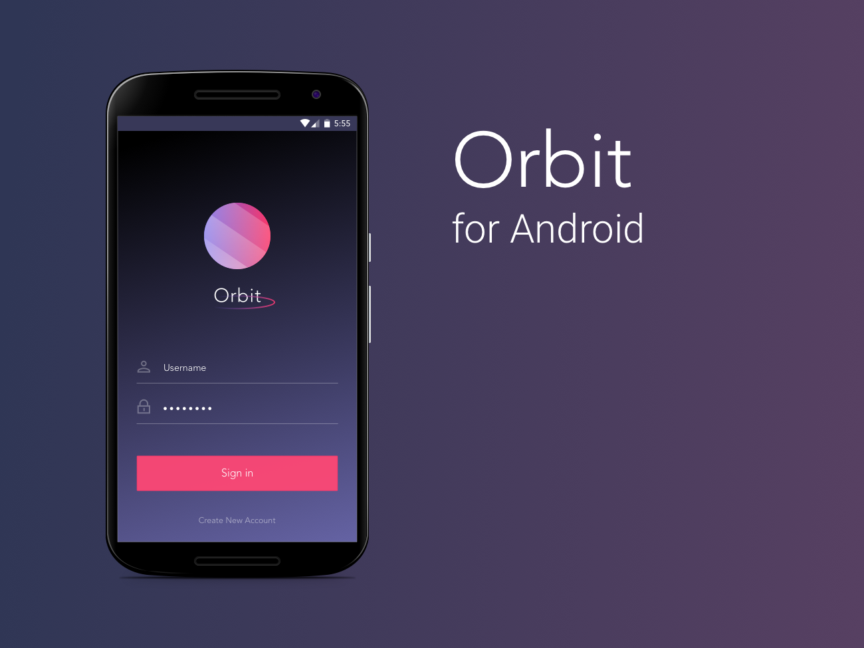
Richard, Carol & Percy

Slide 2



The Orbit Team
DESIGNER
Created wireframes, high-fidelity mockups, prototypes. Communicated product specifications and goals to team.
FULL STACK DEVELOPER
Responsible for frontend and backend development (working with PHP, mySQL, Java, XML).
OPERATIONS
Responsible for frontend layouts (XML) and proposal submission.

Slide 3
What is Orbit?
Orbit is an application that gathers all personal ads and classifieds in one platform creating a space that is accessible and clutter-free.
Value Proposition
Free App:
Organized: students are able to browse through posts sorted by University, and sorted by category.
Specific: The categories are student specific, ranging from subletting to tutoring to car pooling.
Interactive: Users are able to post ads on items they’re selling or services they’re offering as well as browse through other postings from other students that are selling items or offering services.
Spam-free: Orbit eliminates irrelevant spam and maintains the postings through various ways.
Efficient: This application aims to make search more efficient by offering filtering options (by date, cost - out of scope for MVP)
Browse through sorted categories (i.e. sublets, tutoring, carpool, etc).
Post. Browse. Message sellers.
Simplest way to browse with efficiency.

Slide 4



Testimonies
“Every time I want to search for a listing, I have to look through 5 different sources. I wish I could just go to one place to find what I need.”
- 2nd year Western Business Student
“I follow so many groups for housing rental on Facebook and it really clutters my news feed.”
- Facebook user
“Wow this concept is so simple yet so useful and really easy to navigate! I’m hoping to use it when it comes out!”
- Orbit tester
“I think this will expand really fast through word of mouth! Great platform.”
- Kijiji User
“I don’t like using Kijiji because I feel like some of the ads don’t look legit.”
- 1st year AFM Waterloo student
“Sometimes I don’t see my Facebook or Kijiji notifications.”
- UofT student
*Some students giving testimonies preferred to stay anonymous

Slide 5
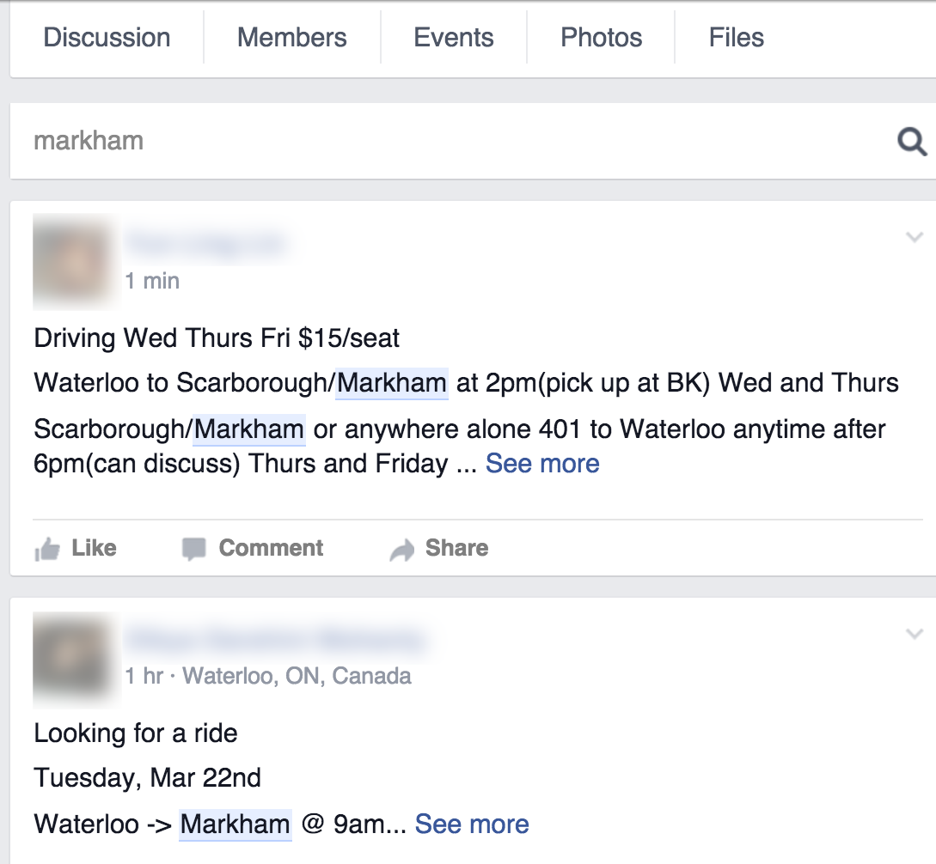
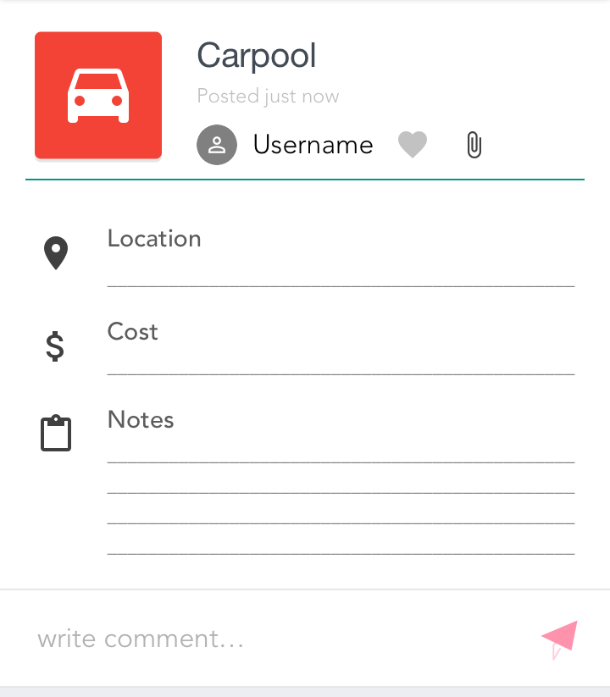
Top 3 issues facing current personal ads/classifieds platform:
Issue 1: Inefficient Search Functions
Can’t filter by date posted, pricing, location, time, etc.
Search Function can’t filter by category (looking/offering a ride).
User must scan through plain text to find fields (i.e. Time, Location Pick Up, etc).
Orbit will category-specific text fields to improve usability and readability.

Slide 6
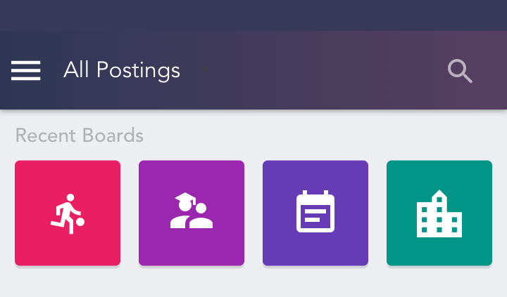
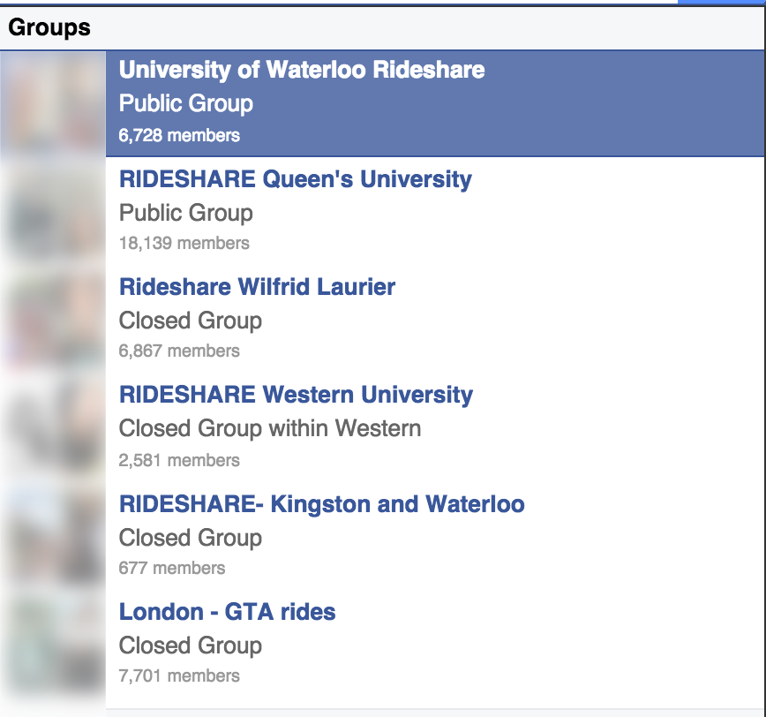
Top 3 issues facing current personal ads/classifieds platform:
Issue 2: Gathering Points and No Maintenance
Orbit will have pre-made category specific boards to ensure there is no overlap. On the home page, users will be able to scroll (horizontally) through their boards.
Many semi-active Facebook groups for the same purpose. There are 3 Rideshare groups for the same area. It is inefficient for the user to search through all 3 groups.

Slide 7
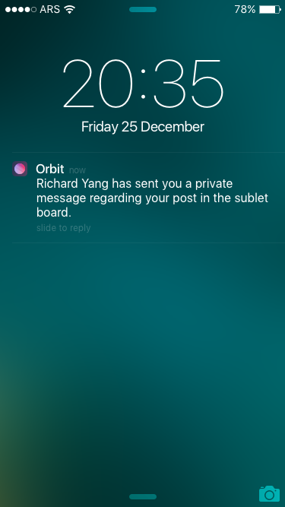
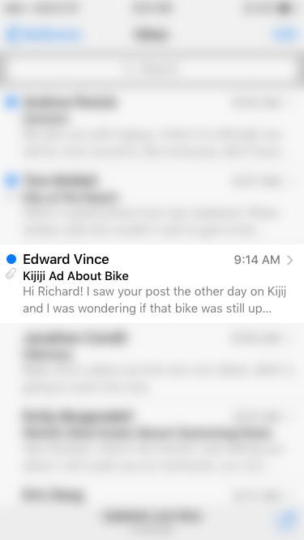
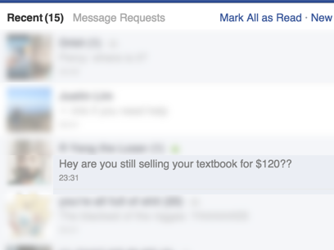
Top 3 issues facing current personal ads/classifieds platform:
Issue 3: Disorganized Communication
No method to differentiate between people interested in your posting vs. friends & contacts.
Orbit will have in-app messaging that can be viewed using the inbox & outbox + push notifications

Slide 8



Competition and Defensibility
Direct Competitors
Characteristics
Orbit Advantages
Not targeted towards students (i.e. irrelevant categories like lawn care, automobile)
Disorganized messaging (emails/texts are lumped together with personal emails/texts)
Pre-made boards that are tailored to specific student needs (i.e. Sublets, Tutoring, Carpool)
Separate messaging feature with inbox/outbox within app
Expired ads are not removed from groups
No limit on postings which generates spam
Groups can be created by anyone causing multiple/overlapping groups
No search function
Posts are removed after 1 week
Users are limited to 5 posts per board each day to eliminate spam
One unified group for each board (UWaterloo has 3-4 semi-active rideshare groups)
Filtered by date, price, etc (out of scope for MVP - to be implemented in future)
Other Competitors

Slide 9

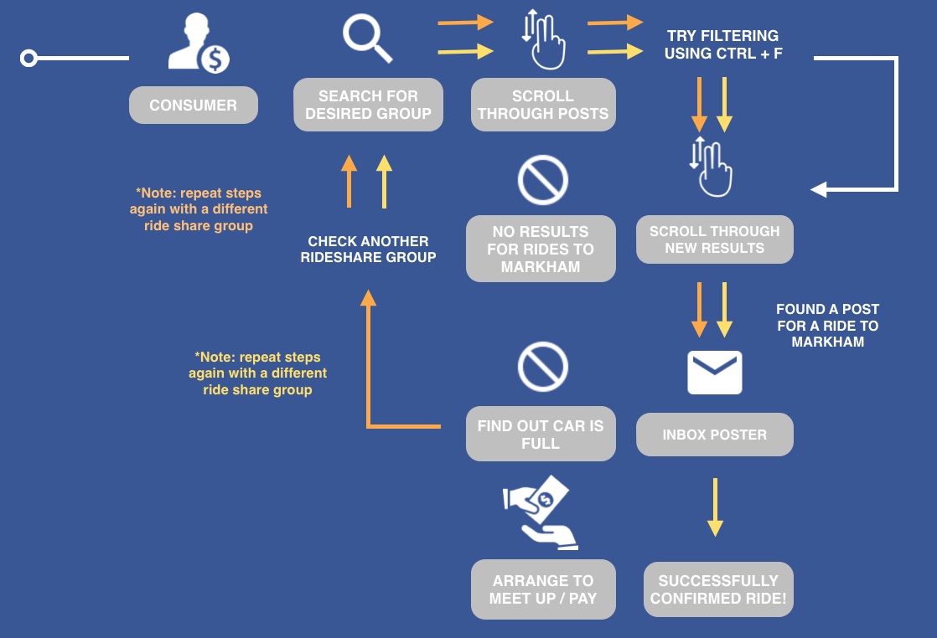
How Competitor’s Work: Facebook
Scenario: A University of Waterloo student is looking for a ride back to Markham, Ontario for the weekend.

Slide 10
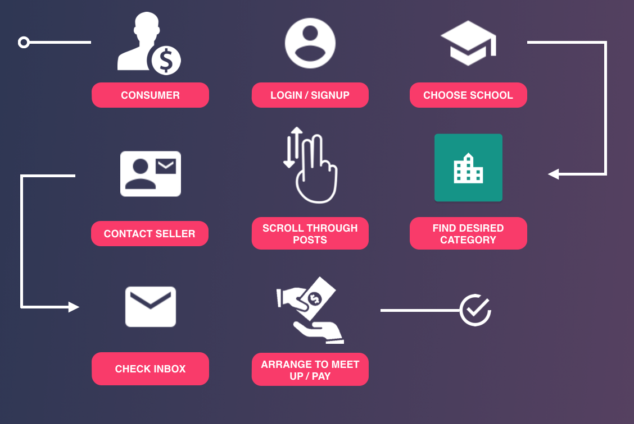
How Orbit works: for the Buyer
Scenario: A University of Waterloo student is looking for a ride back to Markham, Ontario for the weekend.

Slide 11
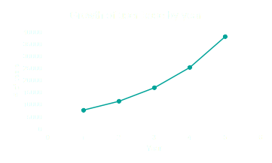
Market Size
Target Consumer: Students
373,000+ students in Ontario universities.
37,000 users by Year 5
Price Sensitive: They tend not to have a lot of income and will try to find the best price for products and services.
Tech-Savvy: They understand how to navigate the web and are very engaged in social media..
Connected: They are connected with their network at all times and are highly influenced by word of mouth and referrals.
Impatient: They live in an instant gratification society expecting to easily find what they are looking for.
*Assume 2% penetration at year 1 and then 50% growth rate YOY for the next 4 years.

Slide 12

Launch Strategy
Generating Initial Content
Approach pre-existing sellers (i.e. housing companies, used textbook stores) to post on Orbit as free advertising
Approach frequent sellers & posters in Facebook groups to post in the app
They will be offered free rewards (through points system - coming soon)
Giveaways & Promotions
Coupons (i.e. free car pool ride)
Perks (i.e. increase posting duration - past typical expiry date of 1 week)
Giveaways (i.e. every posting grants 1 entry into a raffle for a prize)
Student Reps
Hire student reps for all major universities in Ontario for soft launch to facilitate 1 and 2

Slide 13
Software Development Tool Kit
Layout: Used Android Studio XML to create organized layouts that supports multiple phone screen sizes (support for tablet will come soon).
Java: Implemented precise functions and executions with comprehensive functionalities. Established efficient connection to php side through the import of Android Volley library.
PHP: PHP files are stored in digital ocean server, receiving data from Java files and connecting to online MySQL database.
MySQL: Built strong database in MySQL, receiving data from Orbit App through PHP files and sending back response through JSON response.

Slide 14
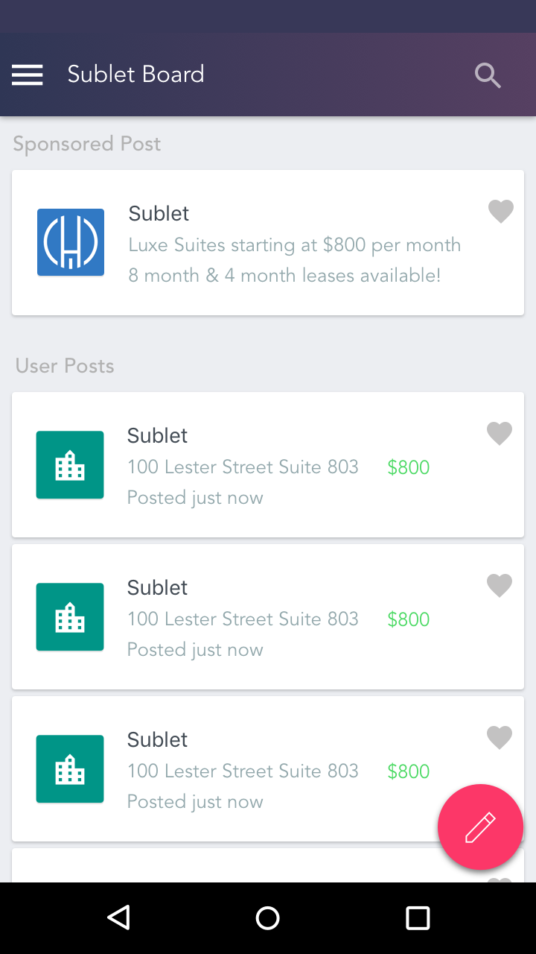
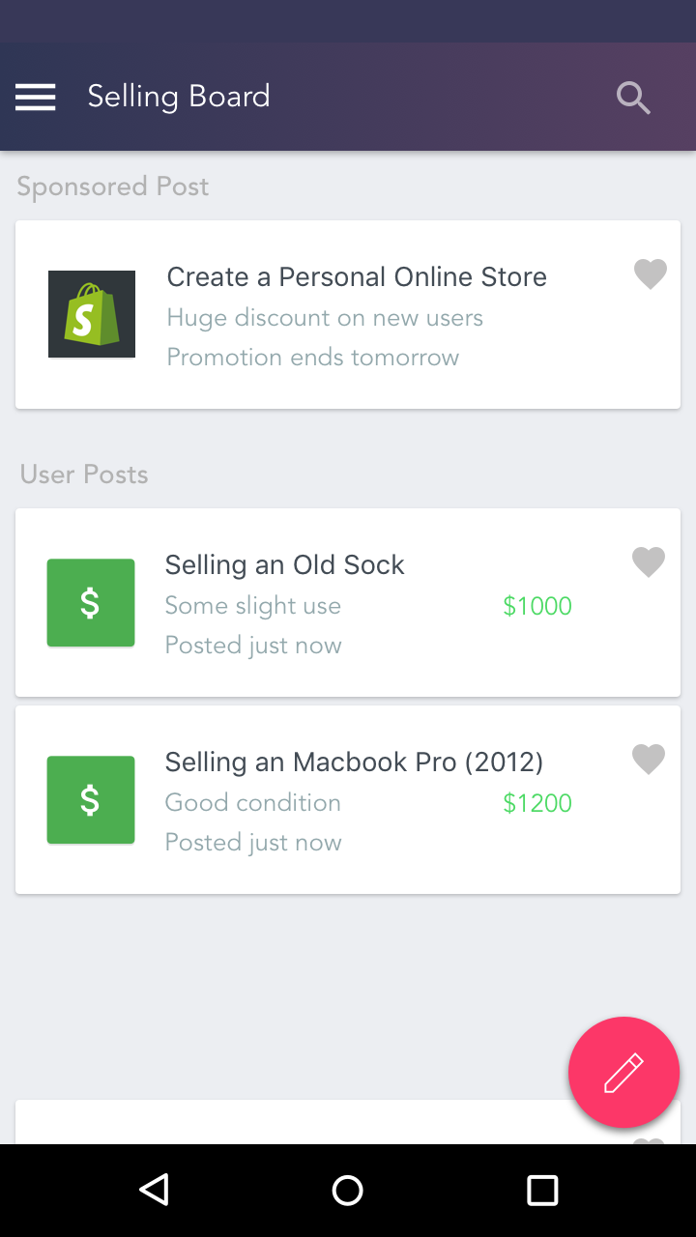
Value & Monetization
Top Ads: Users pay to keep advertisements at the top of the page. These are not invasive and can be scrolled past.
Ads will be charged at $20 per 1000 impressions and $1.20 per click.
Verified Ads: Users pay to have an Orbit “verified” ad. This is done by Orbit inspecting the product or service that is being posted on the platform. This is a highly suggested feature for users posting ads that are high in monetary value.
Verifications will be charged at 5% of the monetary value of the posting.

Slide 15
Metrics to Measure Success
Number of downloads: Obtaining a large number of downloads is the first step for an app to reach its goals. This shows how many users are engaging with the app.
Number of active users: 80% of apps developed are used just once and never used again by a user. Thus, it is important for the team to track the number of active users to determine how to better retain users.
Number of posts per day: This is an important metric to determine whether or not Orbit has enough users generating content on the app.
Number of transactions: Orbit facilitates the exchange between different parties so it is important that transactions are occurring.
Revenue generated: It is important for the app to be able to generate revenue through its monetization features.
A combination of all these metrics determine the health of the app and can help increase the success of the app.

Slide 16
Risks & Mitigations (Our Solutions)
Risk: It may take time for students to adopt this new platform.
Mitigation: We have developed a set of Launch strategies. The implementation process will first focus on major universities where we will attract a stable consumer base and then expand to other universities.
Risk: Lack of content on our platform to start and may deter away users.
Mitigation: We will not launch the application until we have a steady feed of classifieds on our app. We will also reach out to other platforms such as the different Facebook groups for potential partnership in sharing APIs.
Risk: The app may get many download hits, but users may not be active.
Mitigation: By tracking the number of active users over time, it will allow Orbit to be aware of the user retention rate and help Orbit better understand what features can retain users.

Slide 17
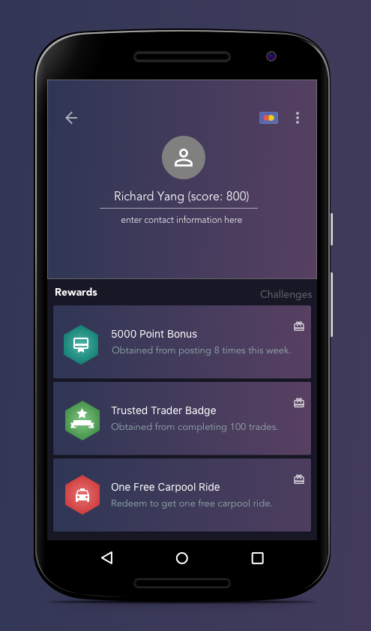
Gamification (Out of Scope)
***Out of scope for now*** can possibly make it for round 2
Gamification drives social engagement, users will refer friends for points, etc.
Rewards users when they perform actions that benefit the app (i.e. in app transactions, new postings, etc). Encourage them to use the app over our competitors.
Promotions & coupons are awarded to users through badges and rewards (i.e. 1 free car pool ride after posting 10 times in the carpool board)
Tracking points and earning badges will be fun. Users can compete with friends.

Slide 18
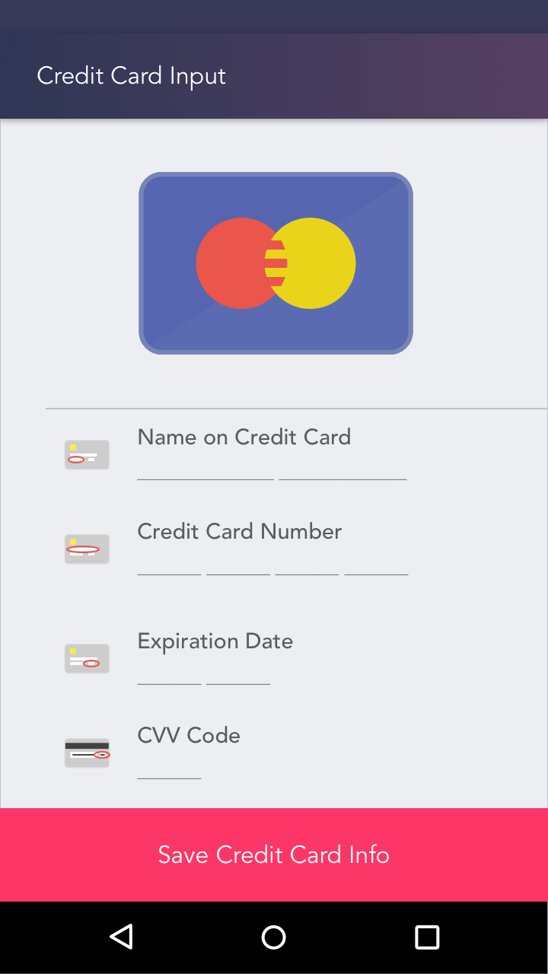
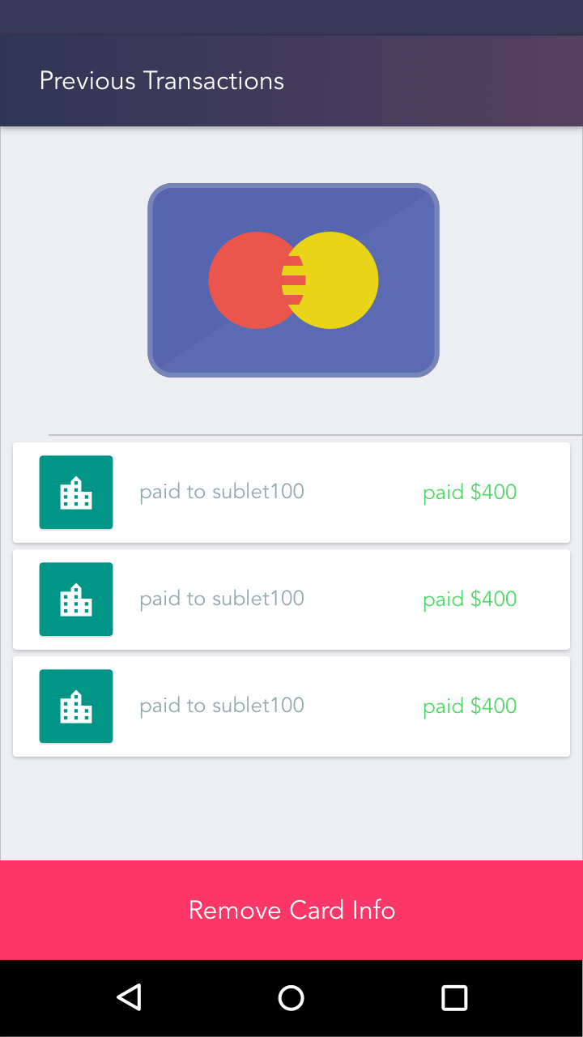
In App Purchases (Out of Scope)
Users can set up a method of payment for in-app purchases where payment goes directly to seller.

